Slide 1

Mid-Term Evaluation <Title of Mini Project> SMS Spam Detector Raj Jaiswal 57 Ashish Yadav 58 Allan Rodrigues 59
Jonathan Sardinha 60
St. Francis Institute of Technology
Department of Information Technology
Mini Project – 2B Web Based on ML (ITM 601)
Mid-Term Evaluation
GUIDE
Dr Minal Lopes

Slide 2
Outline
Introduction
Problem Statement
Methodology
Implementation
Results and Discussion
Conclusion
References

Slide 3
Introduction
The popularity of mobile devices is increasing day by day as they provide a large variety of services by reducing the cost of services.
Short Message Service (SMS) is considered one of the widely used communication service.
However, this has led to an increase in mobile devices attacks like SMS Spam.
In this project, we present a approach that can detect and filter the spam messages using machine learning classification algorithms.

Slide 4
Literature Review
Ref. No | Paper | Ml Algorithm | Review
1. | SMS Spam Detection Using Non content Features | In this project spam detection was done using features that include temporal and graph topology information but exclude content, thus addressing user privacy issues. Focus is on identifying professional spammers on the basis of overall message-sending patterns. Finding SMS spam is done on the server side, given that client-side detection requires mostly content-and ID-based solutions. Algorithm used is support vector machine (SVM) and k -nearest neighbor (k -NN) algorithms | Experiment results show that by using only set of static features to train the classifier , a performance of AUC of 88.3% is achieved. If temporal and network features are used individually, the AUC can get additional 7 and 8 percent improvements, respectively. These results indicate that, compared with static features, network properties and temporal information in an SMS communication network can indeed help achieve better performance

Slide 5
Literature Review
Ref. No | Paper | Ml algorithm | Review
2. | SMS Spam Detection using Machine Learning Approach | The highest accuracy achieved is from Multinomial NB with the accuracy of 98.88%.The second highest accuracy is from SVM is 98.86% close to Multinomial NB. The other three algorithms were k-nearest neighbor, random forests and adaboost with decision trees with accuracy of 97.47%, 98.57% and 98.59% | From simulation results, multinomial naive Bayes with laplace smoothing and SVM with linear kernel are among the best classifiers for SMS spam detection.The best classifier is the one utilizing SVM as the learning algorithm,which yields overall accuracy of 97.64%. Adding meaningful features such as the length of messages in number of characters, adding certain thresholds for the length, and analyzing the learning curves and misclassified data have been the factors that contributed to this improvement in results

Slide 6
Literature Review
Ref. No | Paper | Ml algorithm | Review
3 | SMS Spam Detection using H2O Framework | The H20 framework consists of a set of processes: the first one is the selection of dataset, then the features will be selected and extracted from the dataset. In the next process, the classification methods will be determined; this framework will use three classifiers: random forest, deep learning and naïve bays moreover all the experiments will be made in H2O platform. After that, the evaluation metrics will be specified and comparison can be made between classifiers. | Results showed that RF is the best algorithm in term of precision, recall, f-measure and accuracy with 95%, 85% 0.89% 0.97% values respectively, however RF is not the best in term of time. On the other hand, NB is the best classifier in term of runtime with 0.6 seconds. Nevertheless, NB is the worst according to precision, recall, f-measure and accuracy.

Slide 7
Literature Review
Ref. No | Paper | ML algorithm | Review
4 | Spam Detection Approach for Secure Mobile Message Communication Using Machine Learning Algorithm | A spam detection method using machine learning algorithms such as LR, k-nearest neighbor, and decision tree for classification of ham and spam messages. The SMS spam collection dataset was considered for testing of the current research. The dataset was divided into two categories: 30% for testing and 70% for training purpose for the predictive models. | The LR at hyperparameter C = 1 achieved 99% accuracy, 100% specificity, sensitivity 86%, and MCC, 93% and the processing time is 0.494 seconds. The classifier decision tree obtained 98% accuracy, 94% specificity, sensitivity 86%, and MCC 95%, and the processing time is 46.032 seconds. Similarly, the k-nearest neighbor classifier achieved 95% accuracy, 100% specificity, sensitivity 60%, and MCC 80%, and the processing time is 0.630 seconds. Experimental results suggest that LR is the best classifier for the classifications of ham and spam messages

Slide 8
Problem Statement
The aim of this project is to detect whether the received SMS is a ham or spam.With digital currency many people are prone to smishing attack in which the fraudster sends fake SMS messages pretending to be a reputable company in order to get individuals to reveal their personal information, passwords or credit card details.

Slide 9
Problem Solution
Our SMS Spam Detector checks the SMS entered across various datasets and gives a “Clear” message if the SMS is original and sent from a genuine organization and it will give a warning “Alert” message if the SMS is sent from a fraudster pretending to be a genuine organization
This will help our users to differentiate between spam and actual messages thus saving them from fraud.

Slide 10
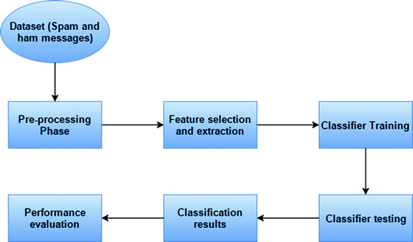
Methodology

Slide 11
Implementation
Dependencies-
pandas==1.3.2
scikit-learn==0.24.2
scipy==1.7.1
Seaborn==0.11.2
Algorithm- Naive Bayes Classifier
Data Collection: In this phase we have used a dataset which has spam as well as ham messages from Kaggle repository.
Data Cleaning: In this phase we have cleansed all the data which was taken into consideration in order to make our dataset ready for building the model

Slide 12
Implementation
Generating Testing and Training Data Sets: We split the dataset into training and testing. 70% of the dataset was used for training purposes and 30% of the dataset was used for testing purposes.
Applying Naïve Bayes Algorithm : We have applied the Naïve Bayes Algorithm for training the Data. On this basis, the spam feature will be classified.
Prediction: We tested how well our model predicts the ham or spam messages. We have given input messages to the model to check whether the message is SPAM or HAM.
Performance Evaluation: We observed the results obtained and calculated the performance metrics of our model

Slide 13
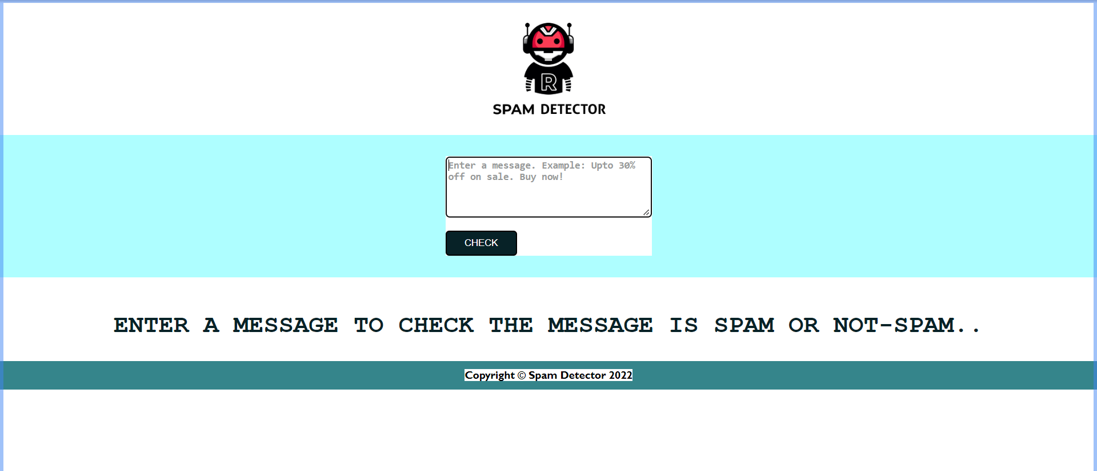
Results
Home page

Slide 14
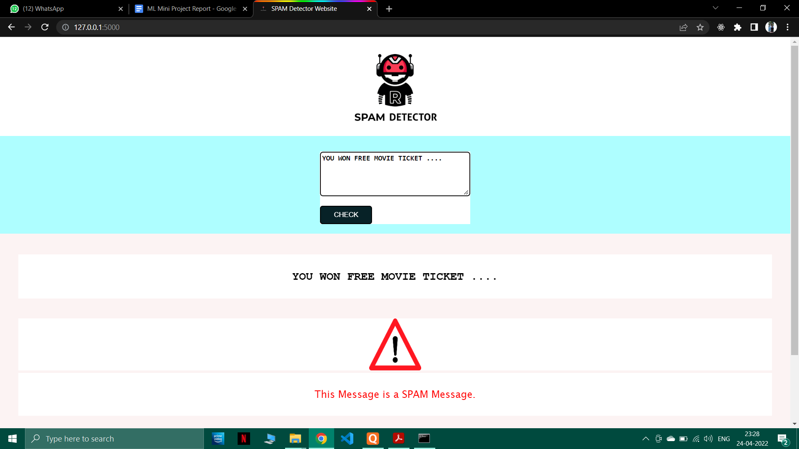
Results
Spam

Slide 15
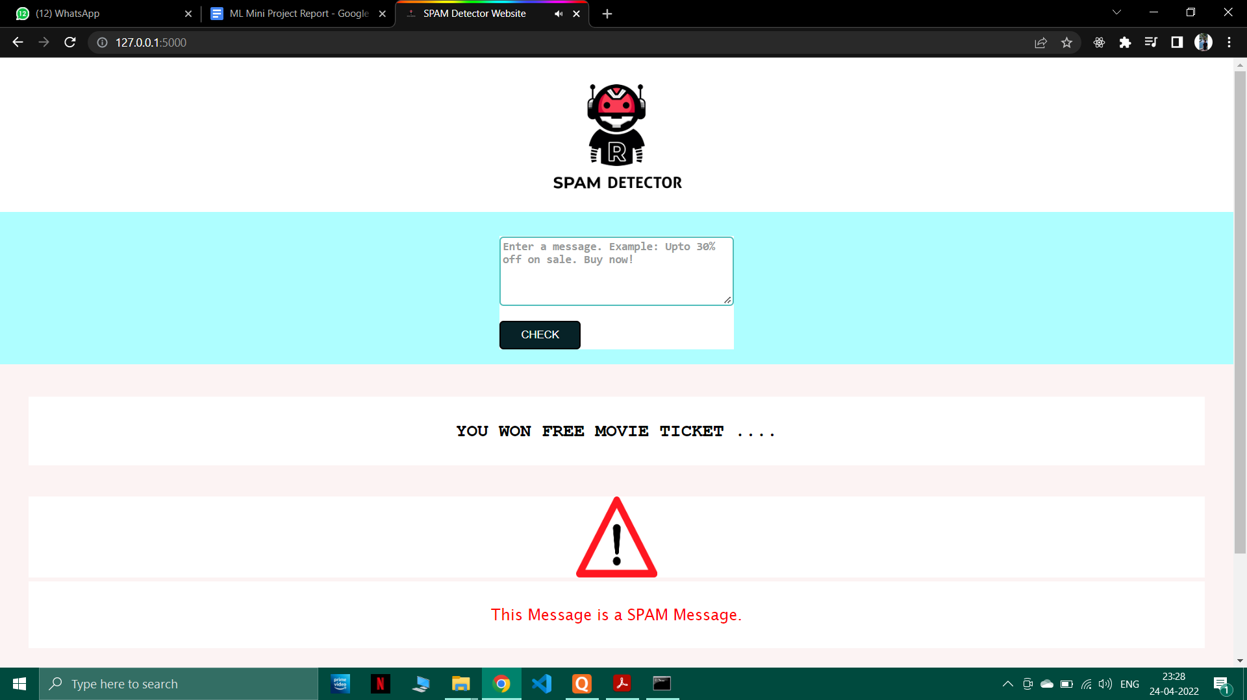
Results

Slide 16
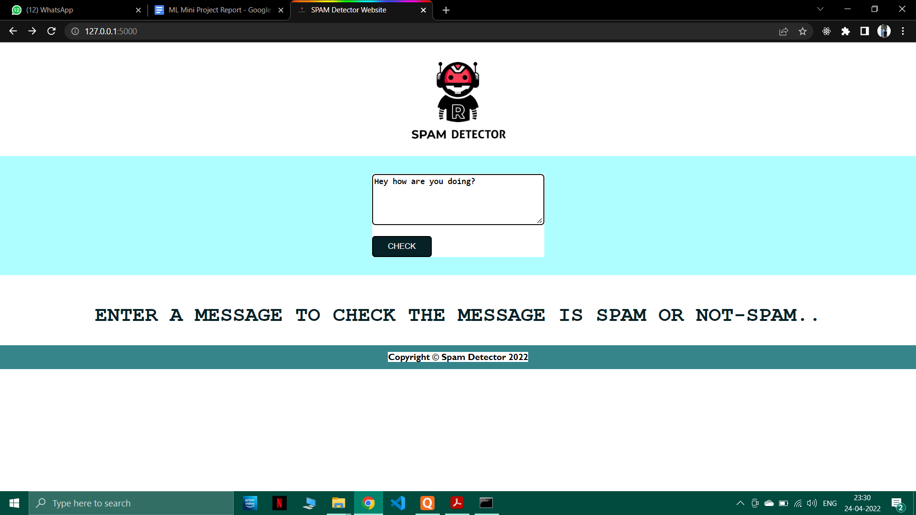
Results
Ham

Slide 17
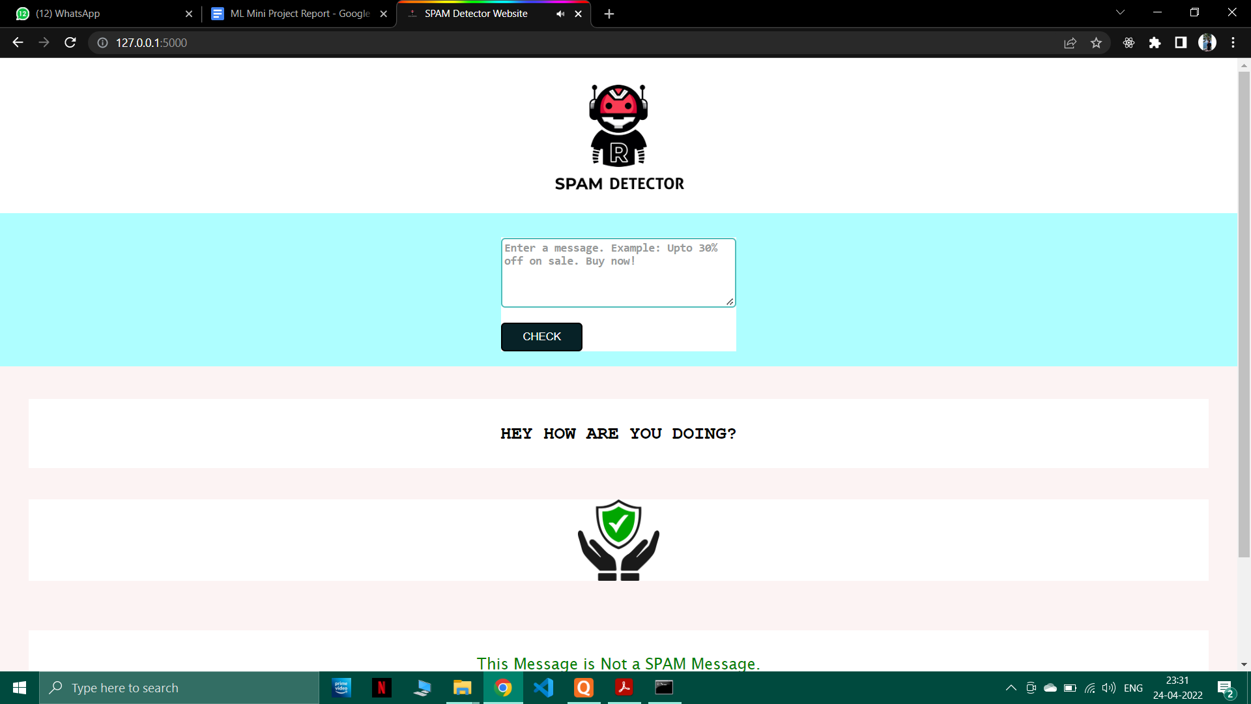
Results

Slide 18
Conclusion
Thus we successfully built a model that can help our users to differentiate between spam SMS messages and actually genuine SMS messages thus saving them from online frauds and smishing attacks.
After calculating the performance metrics such as accuracy, precision, recall and F1 score we observed that the percentage of all these metrics was above 95% for Naives Bayes classifier with the ideal (strong) value being close to 1.
Hence we can conclude that the Naive Bayes Classifier will give us quite accurate results and is a more than reliable machine learning algorithm to detect Spam messages.

Slide 19
References
[1] Xu, Qian, et al. "Sms spam detection using noncontent features." IEEE Intelligent Systems 27.6 (2012): 44-51.
[2] Shirani-Mehr, Houshmand. "SMS spam detection using machine learning approach." unpublished) http://cs229. stanford. edu/proj2013/Shir aniMeh r-SMSSpamDetectionUsingMachineLearningApproach. pdf (2013).
[3] Suleiman, Dima, and Ghazi Al-Naymat. "SMS spam detection using H2O framework." Procedia computer science 113 (2017): 154-161.
[4] GuangJun, Luo, et al. "Spam detection approach for secure mobile message communication using machine learning algorithms." Security and Communication Networks 2020 (2020).

